Slide 1
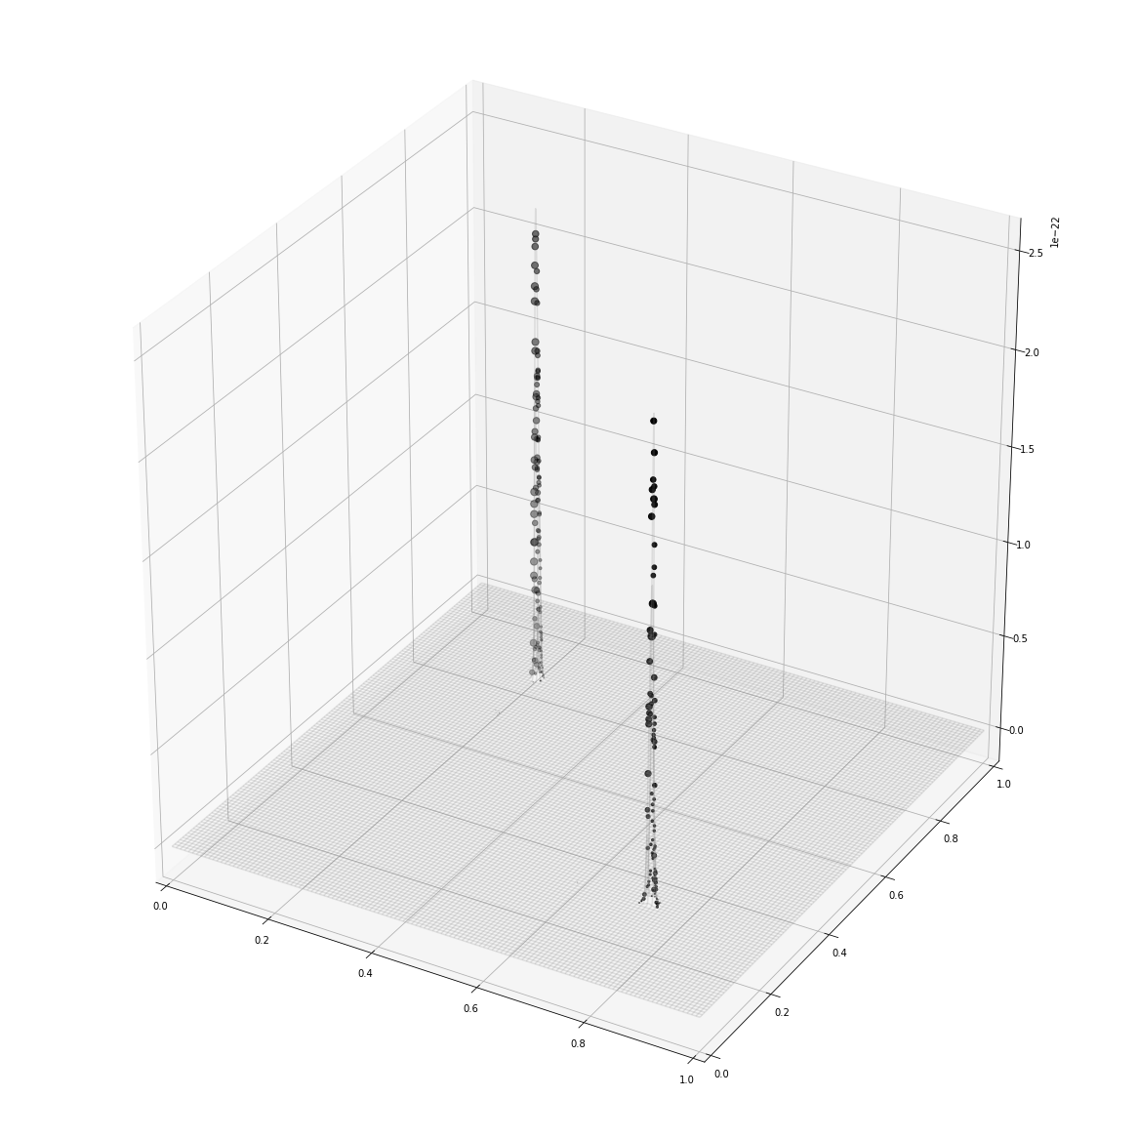
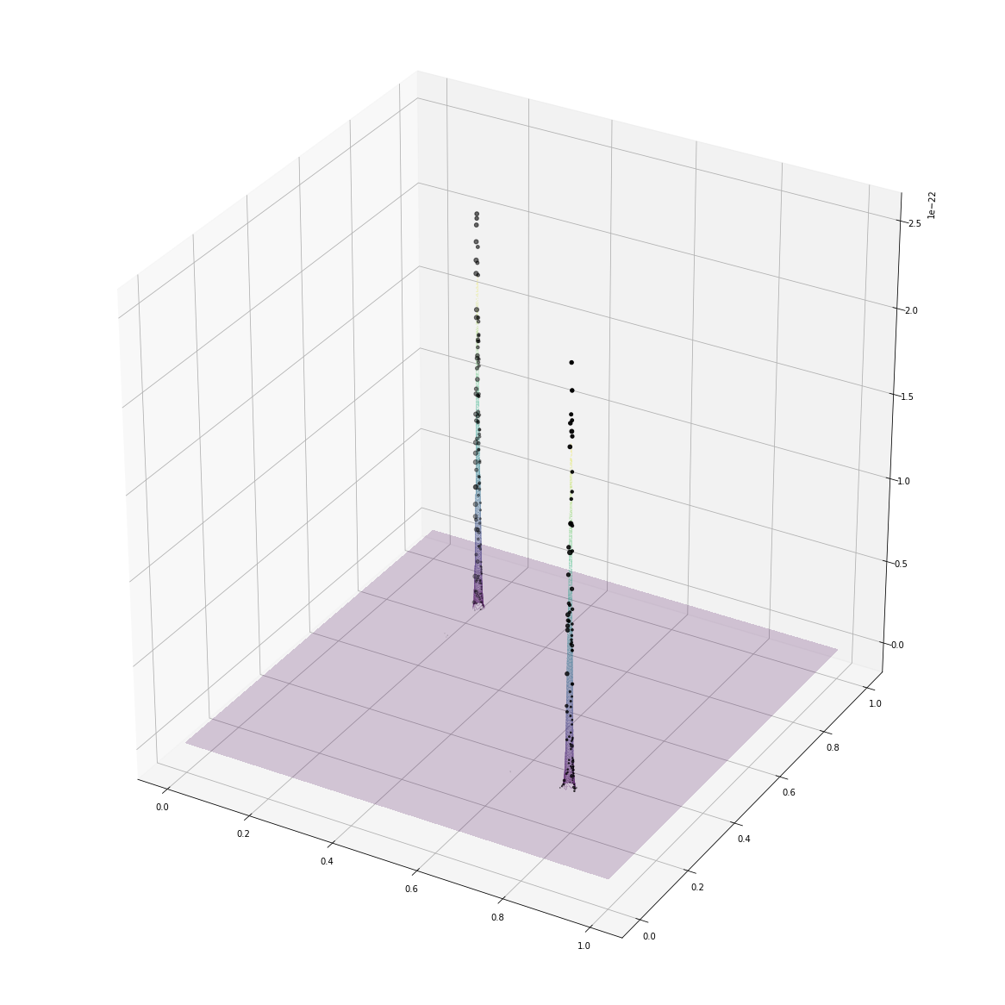
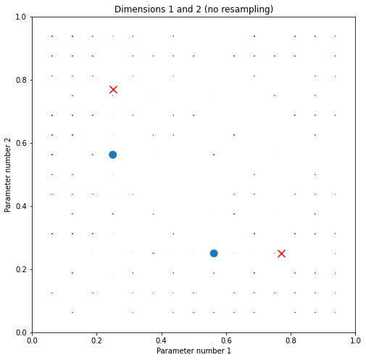
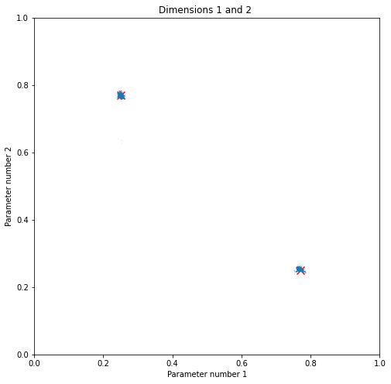
Likelihood vs. distribution plots
Offline estimation: random times <= 100
Uniform prior distribution, data chunksize = 20
1 particle group
HMC: Cov^-1, L=10, eta=0.0100000000
> n=15.00^2; N=100; 2d sum of squared cosines
* Total resampler calls: 3.
* Percentage of HMC steps: 100.0%.
* Hamiltonian Monte Carlo: 84% mean particle acceptance rate.

Slide 2
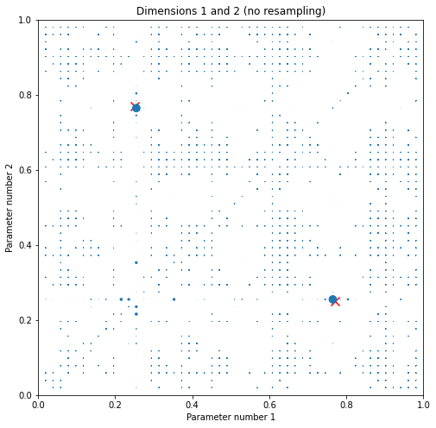
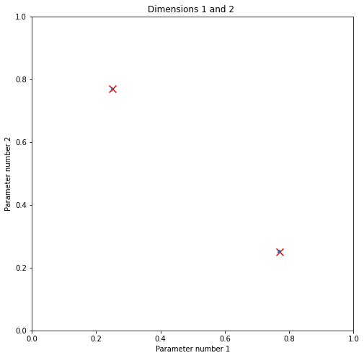
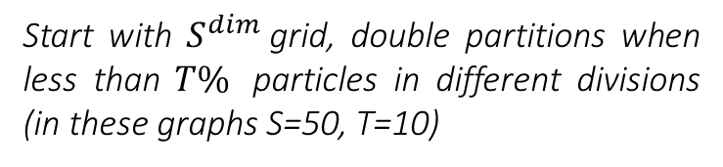
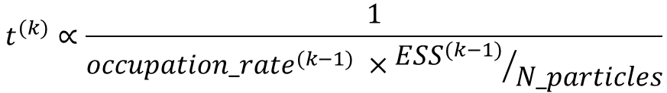
Adaptive measurement choice
$$t^{(k)}∝\frac{1}{{occupation_rate}^{(k−1)} ×{{ESS}^{(k−1)}}/{N_particles}}$$
Start with $S^{dim}$grid, double partitions when less than $T\%$ particles in different divisions (in these graphs S=50, T=10)
(to increase times
between resampler calls)

Slide 3
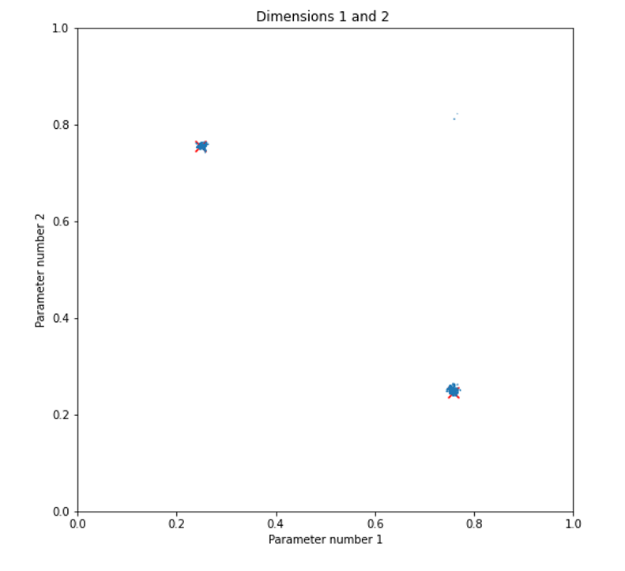
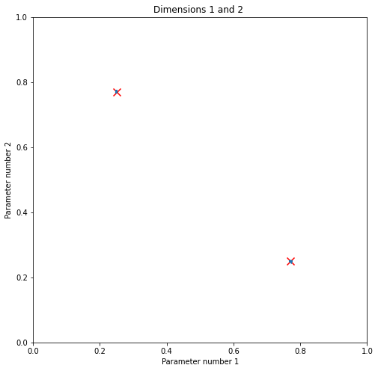
Offline (L) vs. adaptive (R) estimation
2d sum of squared cosines, single group/run (selected best across several for both)
Resampling threshold = 100
100 measurements/updates, 15^2 particles
HMC: Cov^-1, L=10, eta=0.01*N(1,V=0.25)
MH: S=Cov, factor=0.0010
Offline estimation: random times <= 100
Adaptive estimation: times from ~ 1 to 1800
* Total resampler calls: 17.
* Percentage of HMC steps: 45.4%.
* Hamiltonian Monte Carlo: 87% mean particle acceptance rate.
* Metropolis-Hastings: 38% mean particle acceptance rate.
* Total resampler calls: 12.
* Percentage of HMC steps: 100.0%.
* Hamiltonian Monte Carlo: 95% mean particle acceptance rate.

Slide 4
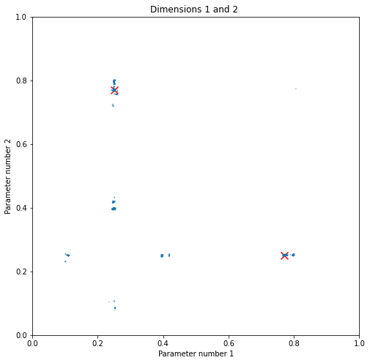
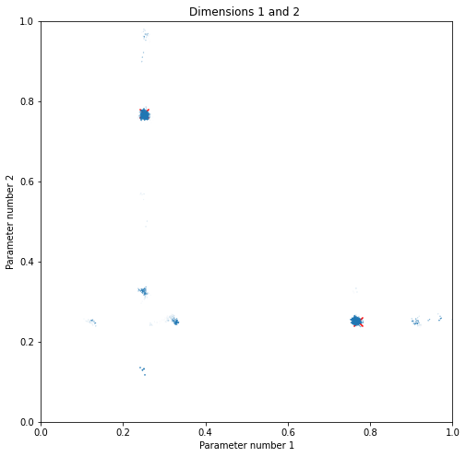

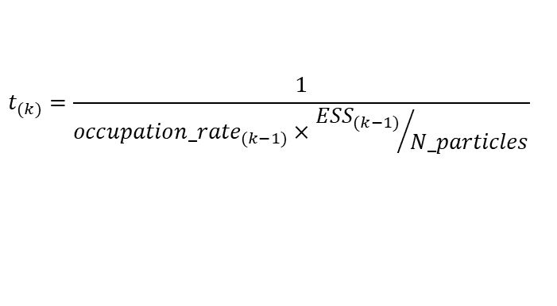
Offline (L) vs. adaptive (R) estimation
5 independent particle groups
$$random times≤100$$
$$t_{(k)}=\frac{1}{{occupation_rate}_{(k−1)}×{{ESS}_{(k−1)}}/{N_particles}}$$

Slide 5
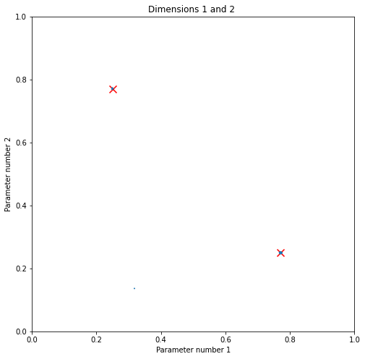



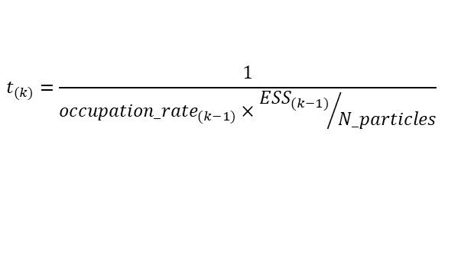

Offline (L/C) vs. adaptive (R) estimation
Attempting to mimic adaptive strategy by increasing maximum evolution time (selected good runs among 3 for all):
$$t_{max}^{(k)}=(\text{k}\text{//}groupsize\text{+1)}×increment$$
$$t_{max}=100$$
$$t_{max}^{(k)}=(\text{k}\text{//}20\text{+1)}×100$$
$$t_{(k)}=\frac{1}{{occupation_rate}_{(k−1)}×{{ESS}_{(k−1)}}/{N_particles}}$$
(then choose randomly from $\left[0,t_{max}\right[$)

Slide 6
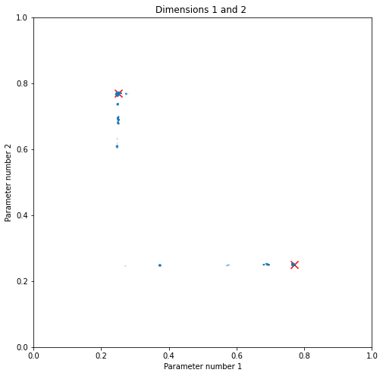
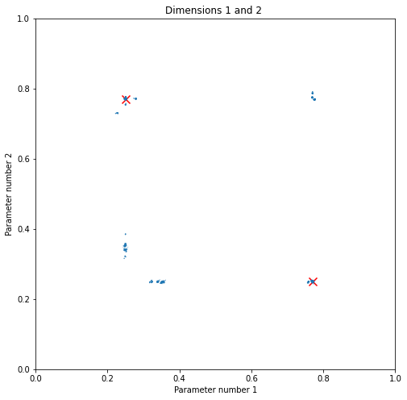
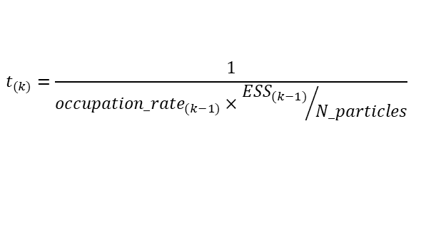

Offline (L) vs. adaptive (R) estimation
For 5 independent particle groups:
$$t_{max}^{(k)}=(\text{k}\text{//}20\text{+1)}×100$$
$$t_{(k)}=\frac{1}{{occupation_rate}_{(k−1)}×{{ESS}_{(k−1)}}/{N_particles}}$$

Slide 7
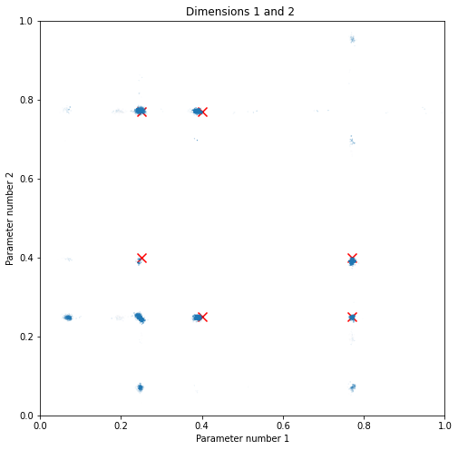
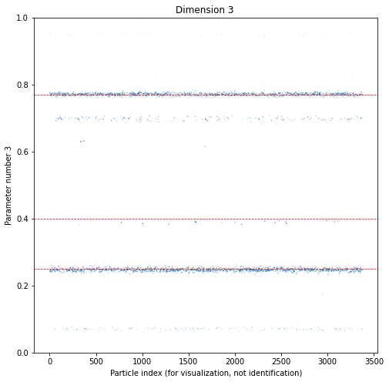
Adaptive estimation: 3d
Times work very differently for higher dimensionality parameter space (because the downtrend in particle density is too steep due to the volume increasing too fast with the dimensionality?)
Works better if taking fractional roots of the spatial occupation (here square), but hard to tune (sides and threshold for occupation estimate, powers for computing the times’ denominators, proportionality factor)

Slide 8
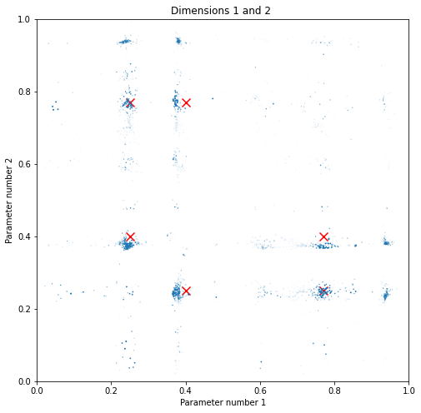
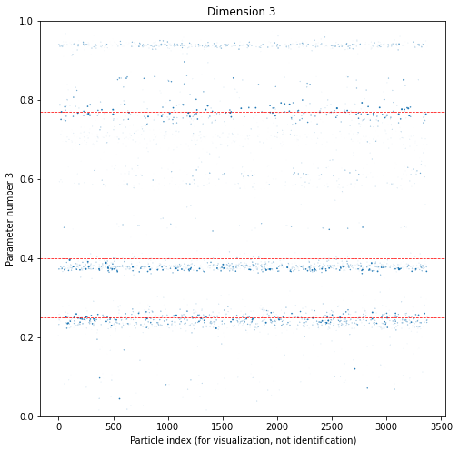
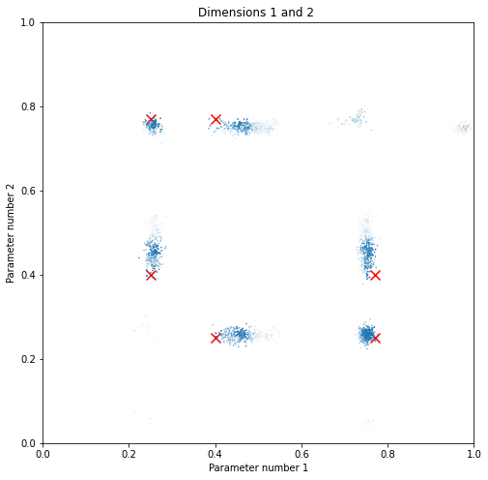
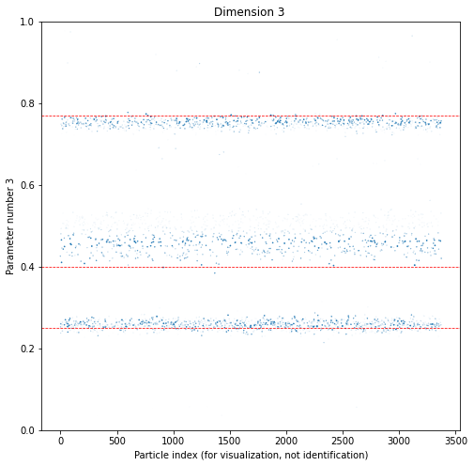
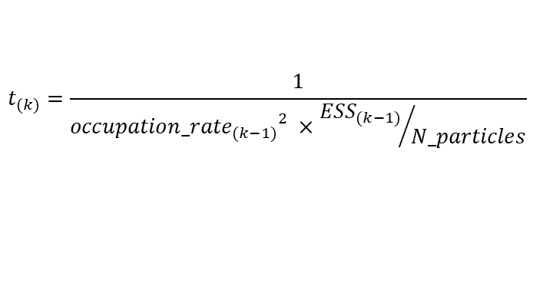
Offline (L) vs. adaptive (R) estimation
Testing with scarce data/particles to evaluate information quality:
$$t_{(k)}=\frac{1}{{{occupation_rate}_{(k−1)}}^{2} ×{{ESS}_{(k−1)}}/{N_particles}}$$
$$random times≤100$$

Slide 9
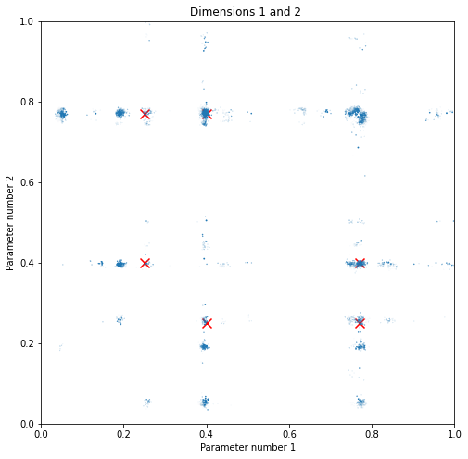
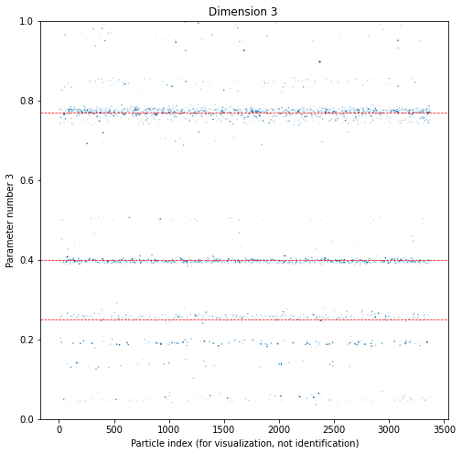

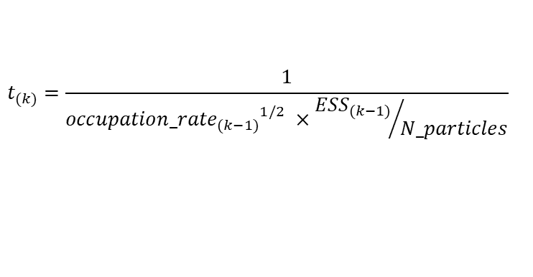
Offline (L) vs. adaptive (R) estimation, 3d
Again using increasing times (vs. random with fixed maxima) also in the adaptive case (all else equal):
$$t_{max}^{(k)}=\text{(}\text{k}\text{//}20\text{+1)}×50$$
$$t_{(k)}=\frac{1}{{{occupation_rate}_{(k−1)}}^{1/2} ×{{ESS}_{(k−1)}}/{N_particles}}$$

Slide 10
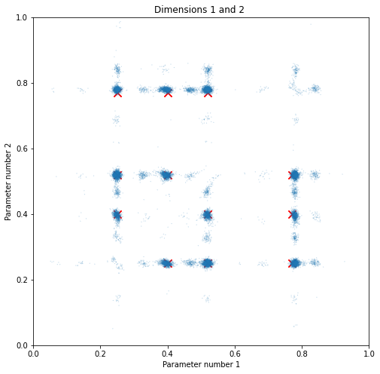
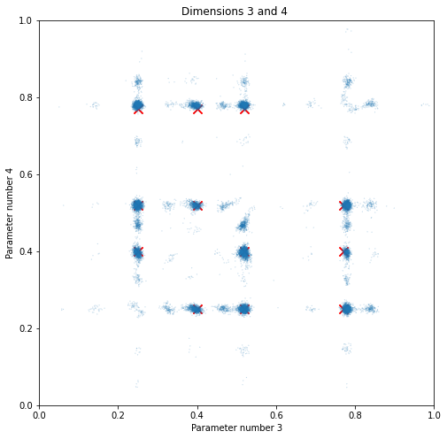
Tempered likelihood estimation
4 parameters, 24 modes (n_particles=12^4; N_measurements=250):
Offline estimation, random times <= 100
5 steps only, but full data evaluation and resampling step at each iteration (vs. as before single datum/datachunk added per step, isolated evaluation(s) for re-weighting + cumulative only if/when resampling)
Tempering coefficients chosen offline, spaced evenly (enough to keep ESS reasonable while not requiring extra updates, though ideally chosen adaptively to stay close to target)

Slide 11
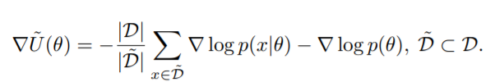

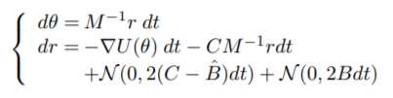
Subsampling I – Stochastic Gradient HMC
Skip Metropolis-Hastins acceptance/rejection step, control induced error by keeping HMC integration stepsize small
Chen et al, Stochastic Gradient Hamiltonian Monte Carlo, 2014

Slide 12
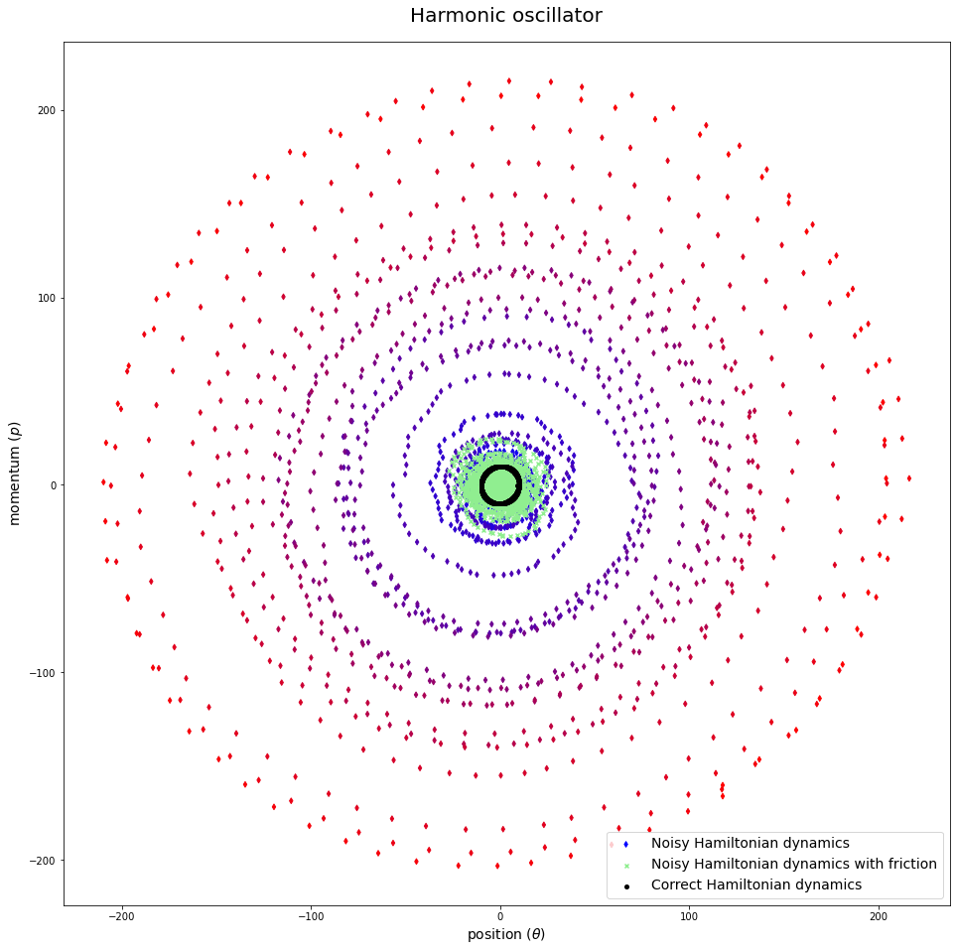
Noisy hamiltonian dynamics: oscillator
noise induced divergence, target distribution no longer invariant under dynamics
controlling divergence with second order Langevin dynamics

Slide 13
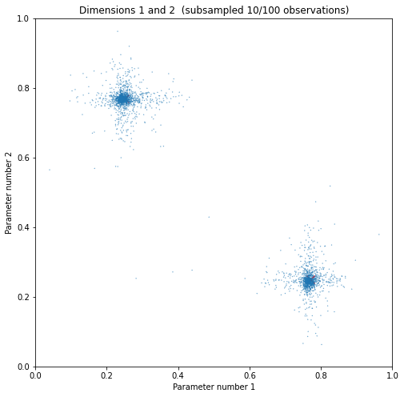
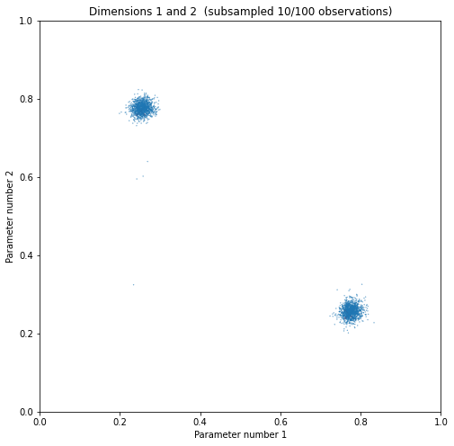
Subsampling – Stochastic Gradient HSMC
No compensations (B=0,C=0)
Introduced friction (B=500,C=1500)

Slide 14

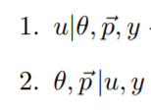
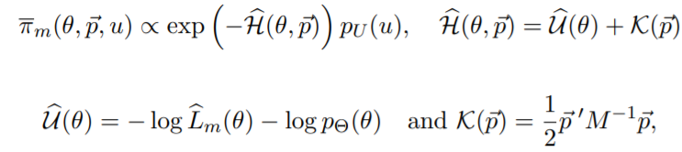
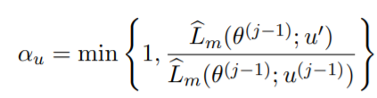
Approach II: energy conserving subsampling
Using unbiased estimators for the re-weightings/gradients/rejection steps (so the error won’t scale with ε)
Target perturbed posterior:
For the Markov moves, perform Gibbs update with pseudo-marginal Metropolis (within Gibbs; for subsampling indices, discrete and ill-suited for HMC) + HMC (again within Gibbs; for parameter vector)
(then marginalize over momentum/indices for ϴ samples)
Dang et al, Hamiltonian Monte Carlo with Energy Conserving Subsampling, 2019
Gunawan et al, Subsampling Sequential Monte Carlo for Static Bayesian Models, 2020

Slide 15


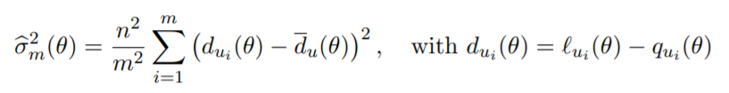
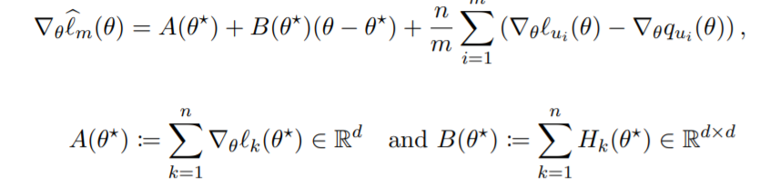
Approach II: energy conserving subsampling
(unimodality assumption)
(and similarly for variance estimator gradient)
Dang et al, Hamiltonian Monte Carlo with Energy Conserving Subsampling, 2019
Gunawan et al, Subsampling Sequential Monte Carlo for Static Bayesian Models, 2020

Slide 16
Energy conserving subsampling
E.g., for some random choice of dataset/parameters/tempering coefficients/...:
* Loglikelihood estimator:
Estimator: -84.08223429811831
Variance: 1.802785169517362e-10
Exact: -84.08224295758596
* Likelihood estimator:
Estimator: 3.0447358315511755e-37
Exact: 3.044709466148359e-37
* Ratio of tempered likelihoods:
Estimator: 1.6933738301439638e-23
Exact: 1.6933646861716088e-23
[test_estimators]
* Loglikelihood gradients:
Exact gradient: [182.85519201]
Exact estimator gradient: [126.59365506]
Gradient approximation: [112.61529675]
Estimator gradient: [126.59365506]
Gradient estimator: [145.5259525]
* Variance gradients:
Exact variance estimator gradient: [-37.86459486]
Variance gradient estimator: [-37.86459486]
[test_gradient_estimator]
* Loglikelihood approximations:
Exact: -2.3136094233276503
Linear approximation: -2.2970251653956764
Quadratic approximation: -2.3156459493569908
* Log-gradient approximation:
Exact: [3.72314258]
Approximation: [3.5916315]
[test_approximation]

Slide 17
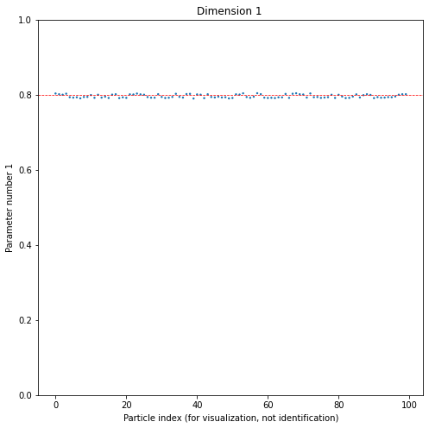
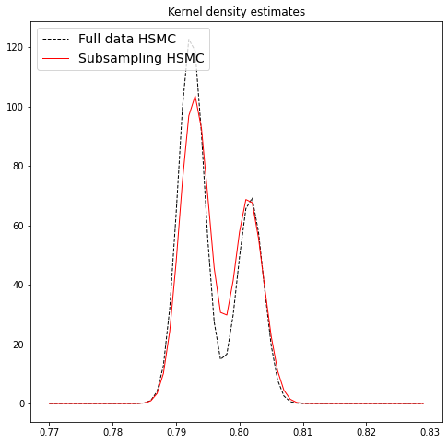
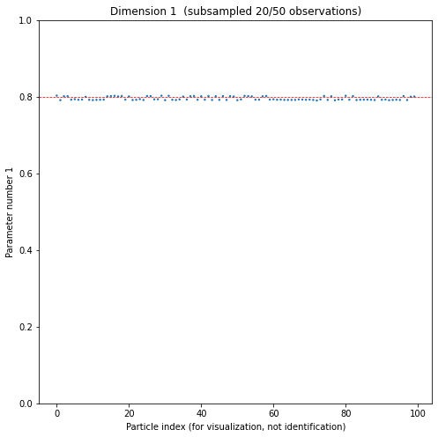
Energy conserving subsampling
Subsampled 20/50 observations
Final (corrected) standard deviations:
- Subsampling: 0.004453
- Full data: 0.004564

Slide 18
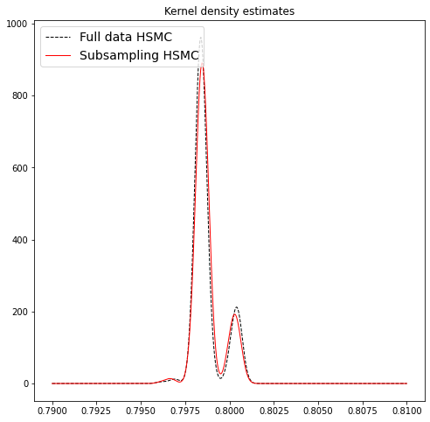
Energy conserving subsampling
Subsampled 50/400 observations
Final (corrected) standard deviations:
- Subsampling: 0.000779
- Full data: 0.000823

